Slide 1
Digital Logic
Introduction
Unit 1

Slide 2
INTRODUCTION ABOUT DIGITAL SYSTEM
A Digital system is an interconnection of digital modules and it is a system that manipulates discrete elements of information that is represented internally in the binary form.
Now a day’s digital systems are used in wide variety of industrial and consumer products such as automated industrial machinery, pocket calculators, microprocessors, digital computers, digital watches, TV games and signal processing and so on.
Characteristics of Digital systems
• Digital systems manipulate discrete elements of information.
• Discrete elements are nothing but the digits such as 10 decimal digits or 26 letters of alphabets and
so on.
• Digital systems use physical quantities called signals to represent discrete elements.
• In digital systems, the signals have two discrete values and are therefore said to be binary.
• A signal in digital system represents one binary digit called a bit. The bit has a value either 0 or 1.

Slide 3
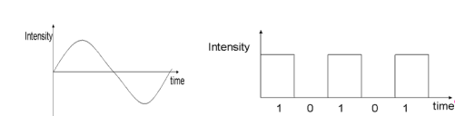
Analog systems vs Digital systems
Analog system process information that varies continuously i.e; they process time varying signals that can take on any values across a continuous range of voltage, current or any physical parameter.
Digital systems use digital circuits that can process digital signals which can take either 0 or 1 for binary system

Slide 4
Advantages of digital system:
Have made possible many scientific, industrial, and commercial advances that would have been unattainable otherwise.
Less expensive
More reliable
Easy to manipulate
Flexibility and Compatibility
Information storage can be easier in digital computer systems than in analog ones. New features can often be added to a digital system more easily too.

Slide 5
Disadvantages of Digital Systems
• Use more energy than analog circuits to accomplish the same tasks, thus producing more heat as well.
• Digital circuits are often fragile, in that if a single piece of digital data is lost or misinterpreted the meaning of large blocks of related data can completely change.
• Digital computer manipulates discrete elements of information by means of a binary code.
• Quantization error during analog signal sampling.

Slide 6
Information Representation
Signals
Information variables represented by physical quantities.
For digital systems, the variables take on discrete values.
Two level or binary values are the most prevalent values in digital systems.
Binary values are represented abstractly by:
digits 0 and 1
words (symbols) False (F) and True (T)
words (symbols) Low (L) and High (H)
and words On and Off.
Binary values are represented by values or ranges of values of physical quantities

Slide 7
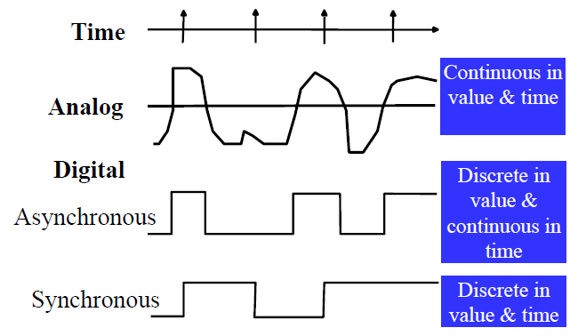
Signal Examples over time

Slide 8
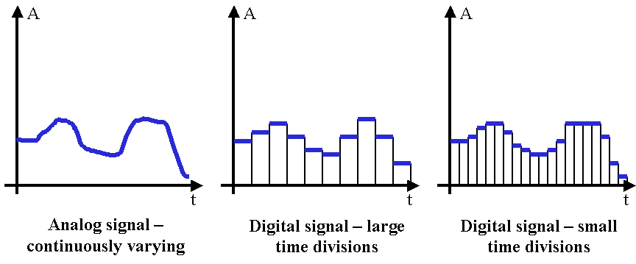
Here is an example waveform of a quantized signal. Notice how the magnitude of the wave can only take certain values, and that creates a step-like appearance. This image is discrete in magnitude, but is continuous in time (asynchronous):

Slide 9
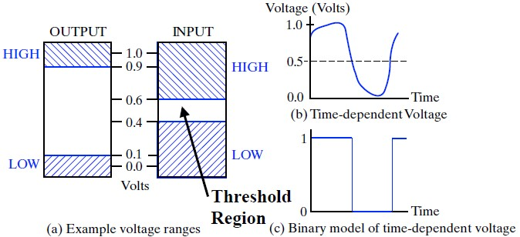
Signal Example – physical quantity: Voltage

Slide 10
Questions:
What are Analog and Digital signals.
Differentiate between Analog System and Digital System.

Slide 11
Previously Used Analog Systems
Cameras
Audio Recording
Video Recording
Telephone Systems
Special Effect in Advertisement and Movies

Slide 12
Examples of Digital Systems
In communication systems
Business Transactions
Traffic Control
Medical Treatment
Industrial Applications
Digital Telephones
Digital TV
Digital Cameras
Weather Monitoring

Slide 13
Various Basic Digital Devices
Logic Gates:
Basic elements that make up a digital system.
An electronic gate is a circuit which is able to operate on a number of binary inputs.
AND, NOT and OR are the basic gates.
Combinational Circuits:
Produces output for a certain specified combination of inputs.
Doesn’t contains memory
Eg. Adder, Subtractor, Multiplexer etc.

Slide 14
Sequential Logic Circuits:
A combinational circuit combines with memory produces Sequential logic circuits.
Eg Flip Flops, Counter etc.

Slide 15
Performance Comparison of Digital And Analog Signals:
Parameter | Analog Signal | Digital Signal
Number of values | Infinite | Finite
Number of Signlas | Continuous time | Discrete time
Nature of signal | Signal generator, transducer | Computers A to D convertr
Examples | Sine wave, triangular wave | Binary signal

Slide 16
Analog and Digital Systems (Comparison):
Parameter | Analog System | Digital System
Type of signal | Analog signal | Digital Signal
Type of Display | Analog meter | Digital Display
Accuracy | Small | High
Design complexity Memory Attached Storage Distortion Communication between systems Noise Effect | Difficult to Design No memory Not possible High Not easy High | Easy to Design Have memory possible Small Easy Low

Slide 17
Clock Signal:
A clock signal (historically also known as logic beat) oscillates between a high and a low state .
A clock signal is produced by a clock generator.

Slide 18
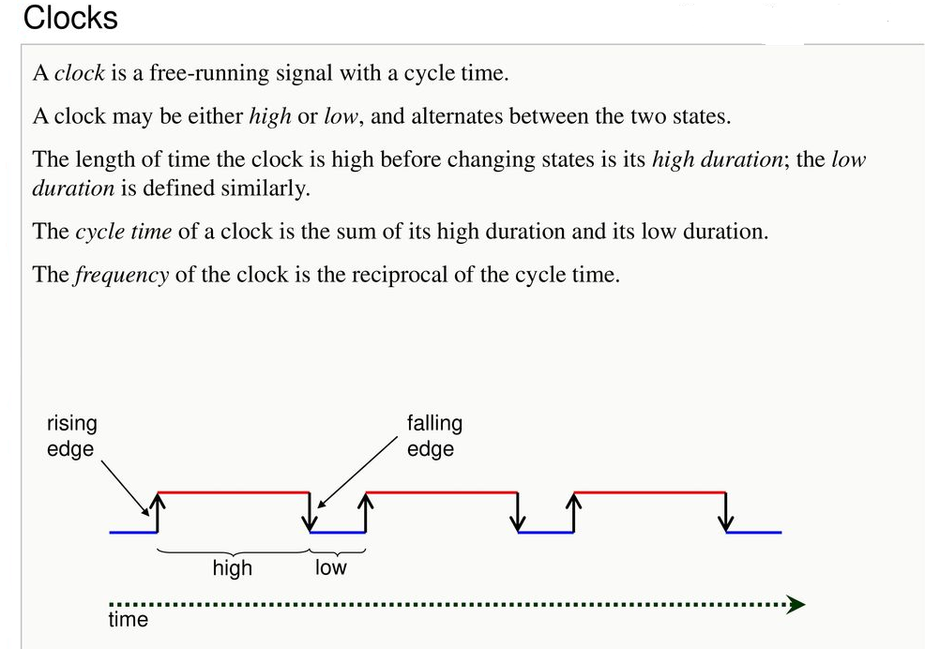

Slide 19
Analog to Digital Conversion:
Analog-to-digital conversion involves four major steps:
Sampling.
Quantization.
Encoding.
Compression (optional)

Slide 20
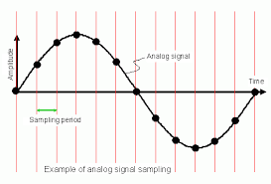
Sampling
The A/D converter captures analog signals at fixed time intervals along the time axis.
This process is known as sampling, and the fixed time interval is known as the sampling period (the inverse of the sampling period is called the sampling frequency)

Slide 21
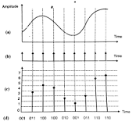
Quantization:
The process of converting continuous sample values into discrete values is called quantization.
• In this process we divide the signal range into a fixed number of intervals.
• Each intervals is of same size and is assigned a number.

Slide 22
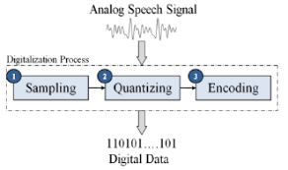
Encoding:
Encoding is the process of mapping the quantized value to the digital word.

